Slide 1


Noida Institute of Engineering and Technology, Greater Noida
Project Control
Unit: V
Project Management
Harshit Thakur
Assistant Professor
CSE
CSE VII SEM

Slide 2
Index
S. No. | Content
1. | Name of Subject with code, Course and Subject Teacher
2. | Brief Introduction of Faculty member with Photograph
3. | Evaluation Scheme
4. | Syllabus
5. | Branch wise Application
6. | Course Objective(s)
7. | Course Outcome(s)
8. | Program Outcomes (PSOs)
9. | Cos and POs Mapping

Slide 3
Index
S. No. | Content
10. | Program Specific Outcomes (PSOs)
11. | Cos and PSOs Mapping
12. | Program Educational Objectives (PEOs)
13. | Result Analysis
14. | End Semester Question paper Templates
15. | Prequisite/Recap
16. | Brief Indtroduction about the Subject with Videos
17. | Unit Contents
18. | Unit Objectives
19. | Topic Objectives/Topic Outcome

Slide 4
Index
S. No. | Content
20. | Lecture related to topic
21. | Daily Quiz
22. | Weekly Assignment
23. | Topic Links
24. | MCQs
25. | Glossary Questions
26. | Old question papers
27. | Expected Questions
28. | Recap of unit

Slide 5
Introduction of Faculty member
Faculty Name: Harshit Thakur
Designation: Assistant Professor
Department: CSE
Email ID: harshit.thakur@niet.co.in
Qualification: M.Tech, B.Tech
Specialisation: CSE
Research Area: Cloud Computing
Total Experience: 1 Year

Slide 6
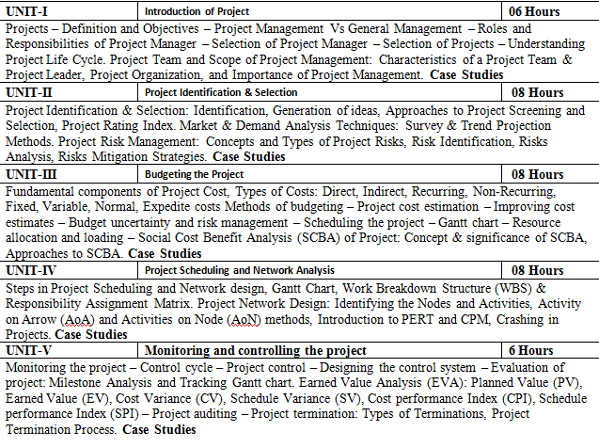
Syllabus

Slide 7
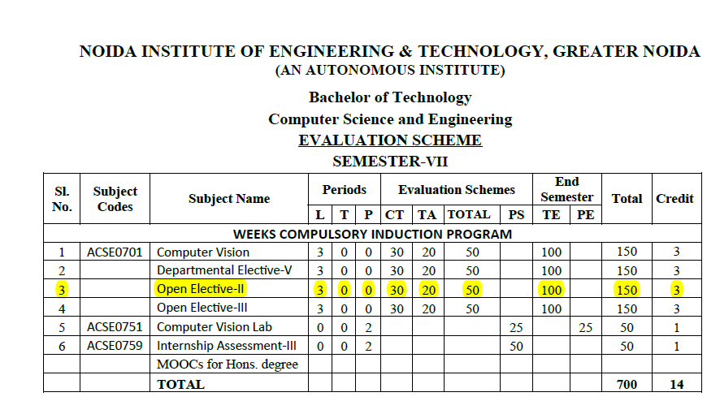
Evaluation Scheme

Slide 8
Branch Wise Application
Handling projects.
Evaluating & Monitoring Project Process
Taking necessary and corrective action.

Slide 9
Course Objectives
To empower the students to get insights of basic concepts on project management.
To create awareness on the roles and responsibilities of project manager.
To build the confident among the students to take up any kind of projects.
To sharpen the planning, scheduling and controlling skills of the students with respect to individual projects.
To understand the perspectives in which optimum decisions are to be taken in case of risks with planned activities in project.

Slide 10
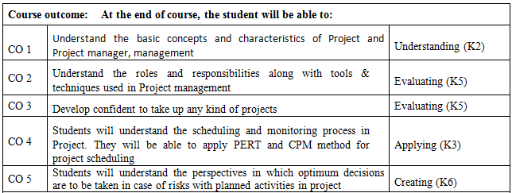
Course Outcome

Slide 11
Program Outcomes
1. Apply knowledge of management theories and practices to solve business problems.
2. Foster analytical and critical thinking abilities for data-based decision making.
3. Ability to develop value based leadership ability.
4. Ability to understand, analyze and communicate global, economic, legal and ethical aspects of business.
5. Ability to lead themselves and others in the achievement of organizational goals, contributing effectively to a team environment.

Slide 12
CO-PO and PSO Mapping
S No | CO/PO | PO1 | PO2 | PO3 | PO4 | PO5 | PO6
1 | CO1 |  | 3 |  | 2
2 | CO2 |  |  | 3 |  |  | 2
3 | CO3 |  | 3
4 | CO4 |  |  | 1 |  | 3
5 | CO 5 | 1 | 2
*1=High, *2=Medium, *3=Low
Program Specific Outcomes | Course Outcomes
 | 1 | 2 | 3 | 4 | 5
1 |  | 3 |  | 1
2 | 1 |  | 1 |  | 2
3 | 1 |  | 2

Slide 13
Program Educational Objective
PEO 1: Graduates of the Management program will have conceptual knowledge, to adapt to the rapidly changing environment, learn new skills and demonstrate application of management principles in a professional work setting.
PEO 2: Graduates will apply appropriate tools for decision making required for solving complex managerial problems in the local or global context.
PEO 3: Graduates of the Management program will exhibit integrity, social responsibility and teamwork.
PEO 4: Graduates will exhibit ethics, communication skills, leadership qualities and entrepreneurial mindset using creativity and innovation.

Slide 14
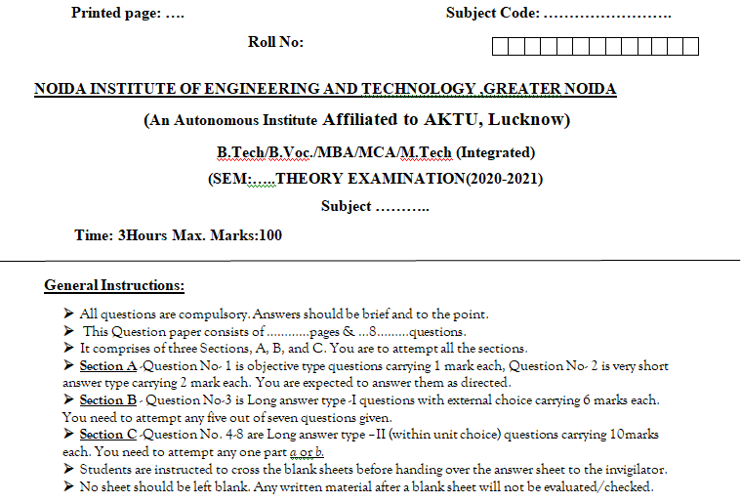
End Semester Question Paper Template

Slide 15
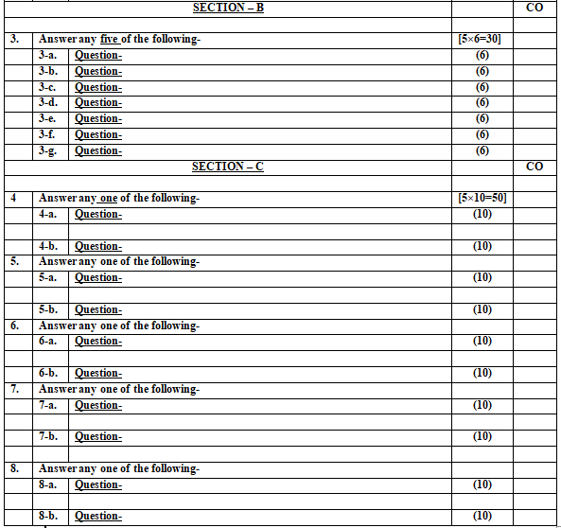
End Semester Question Paper Template

Slide 16
Objective of Unit
Objective of this unit are:
To make the students learn about project and project management.
To make to students understand the project management process.
To make the students know about the project life cycle.

Slide 17
Content of Unit
Unit-1:
Monitoring the project – Control cycle – Project control – Designing the control system .
Evaluation of project: Milestone Analysis and Tracking Gantt chart. Earned Value Analysis (EVA): Planned Value (PV), Earned Value (EV), Cost Variance (CV), Schedule Variance (SV), Cost performance Index (CPI), Schedule performance Index (SPI) – Project auditing –
Project termination: Types of Terminations, Project Termination Process.

Slide 18
Prerequisites and Topic wise Recap
Prerequisites for this session are:
General understanding of project management.
Moderate analytical skills.
Recap:
Project Scheduling and Network Analysis:
Project Network Design:

Slide 19
Topic & CO Mapping
S No | Topic | CO | Level
1 | Project Monitoring and Control | CO 5 | 2
2 | Earned Value Analysis (EVA): | CO 4 | 2
3 | Project Termination | CO 5 | 1

Slide 20
Session/ Topic Objectives
To understand the Project Monitoring and Control.
To perform the Earned Value Analysis and learning about its components.
To understand and learning to execute Project Termination.

Slide 21
Project Monitoring & Control
According to the Project Management Body of Knowledge (PMBOK),
“The Monitoring and Control Process Group consists of those processes performed to observe project execution so that potential problems can be identified in a timely manner and corrective action can be taken, when necessary, to control the execution of the project.”

Slide 22
Monitoring and Control Processes
1. Monitoring and Controlling Project Work
2. Integrated Change Control
3. Scope Verification
4. Scope Control
5. Schedule Control
6. Cost Control
7. Performing Quality Control
8. Managing the Project Team
9. Performance Reporting
10. Managing Stakeholders

Slide 23
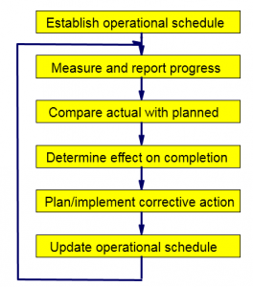
Project monitoring & Control Cycle

Slide 24
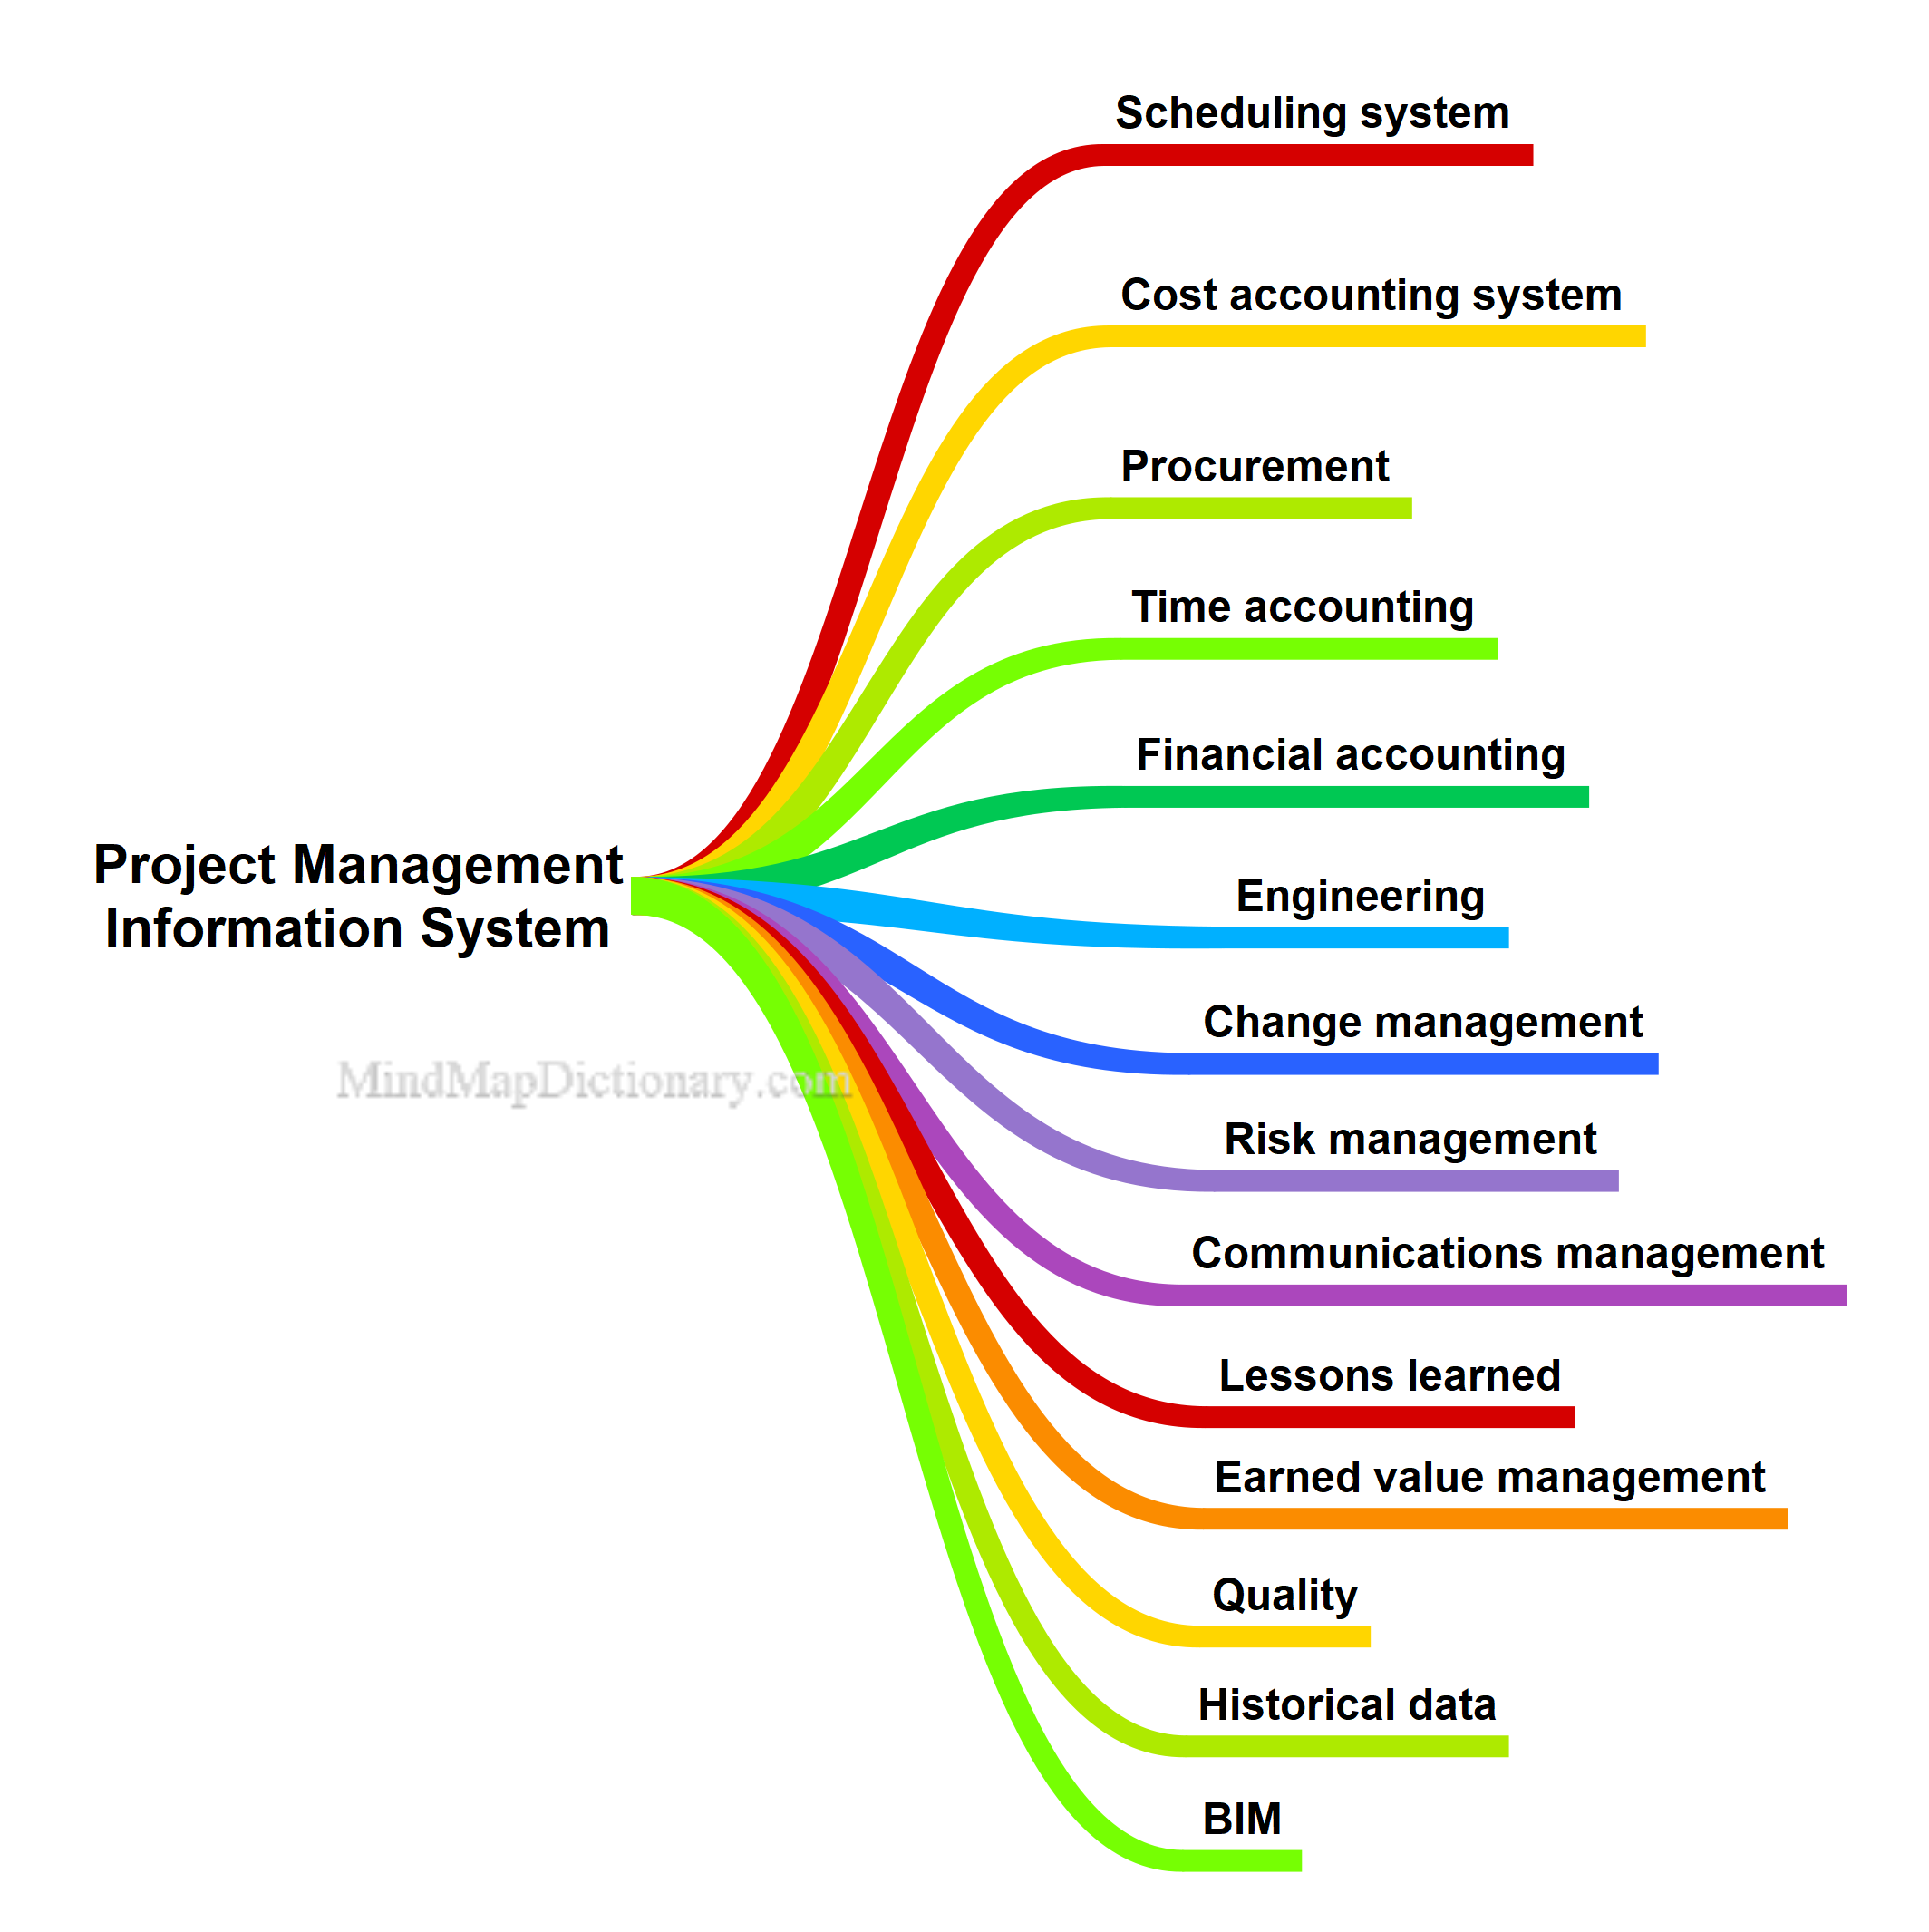
PROJECT MANAGEMENT INFORMATION SYSTEM (PMIS)

Slide 25
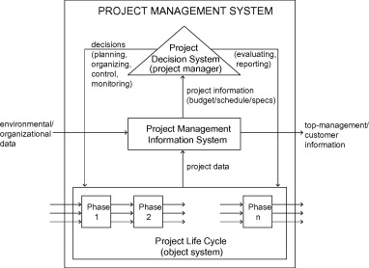
PMIS

Slide 26
Components of a PMIS
Scheduling
Estimating
Resources
Project documents and data
Portals and dashboards
Collaborative work management tools
Social media
Project control

Slide 27
Milestone Analysis
Milestone
Milestones are tools used in project management to mark specific points along a project timeline. These points may signal anchors such as a project start and end date, or a need for external review or input and budget checks.
In many instances, milestones do not impact project duration. Instead, they focus on major progress points that must be reached to achieve success.

Slide 28
Milestone Analysis: Steps
Set the milestones
Reassess after each milestone
Track your progress
Read the nuances

Slide 29
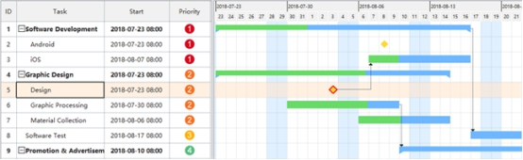
Tracking Gantt Chart

Slide 30
Tracking Gantt Chart
Layout options - options for drawing the links between tasks, date format, bar height, etc.
Bar styles - the styles for drawing the bars and displaying information about bars in the particular view
Text styles - the font styles for the various texts in the view
Bar formatting - the specific formatting of a particular bar in the chart, in case the project manager intentionally changed the format to make the task stand-out from the others by its visual presentation

Slide 31
Tracking Gantt Chart
Row, Column, and Cell Font formatting - the specific font formatting of a particular row, column, or cell in the sheet portion of the view, in case the project manager intentionally applied a different format to highlight the particular task, field, or value
Progress Lines formatting - the progress lines activated for the view and formatting options related to them

Slide 32
Tracking Gantt Chart
Timescale formatting - the formatting of the different timescale tiers, as well as the calendar and presentation of the working and non-working days .
Gridlines formatting - the formatting of the different gridlines for the sheet and chart portions of the view.
Drawings - the different drawings and text boxes placed on the chart by the project manager, in order to place additional information for the tasks or emphasize a certain phase in the plan.

Slide 33
Earned Value Analysis
The earned value analysis is a project controlling procedure that, along with the planned and actual costs, includes the earned value.
Through this the project’s cost efficiency and time efficiency can be calculated.

Slide 34
Earned Value
Oftentimes the term “earned value” is defined as the “budgeted cost of work performed” or BCWP.
This budgeted cost of work performed measure enables the project manager to compute performance indices or burn rates for cost and schedule performance, which provides information on how well the project is doing or performing relative to its original plans.

Slide 35
EVM Foundational Concepts
Earned Value Management Systems allow the project manager to answer the following three questions, as they relate to the project:
Where have we been?
Where are we now?
Where are we going?

Slide 36
Planned Value (PV)
Planned Value describes how far along project work is supposed to be at any given point in the project schedule and cost estimate. Cost and Schedule baseline refers to the physical work scheduled and the approved budget to accomplish the scheduled work.
Together, they result in an important value: Planned Value (PV). PV can be looked at in two ways: cumulative and current.

Slide 37
Planned Value (PV): Cumulative & Current
Cumulative PV is the sum of the approved budget for activities scheduled to be performed to date.
Current PV is the approved budget for activities scheduled to be performed during a given period. This period could represent days, weeks, months, etc.

Slide 38
Earned Value
EV is the quantification of the “worth” of the work done to date.
In other words, EV tells you, in physical terms, what the project has accomplished.

Slide 39
Earned Value: Cumulative & Current
Cumulative EV is the sum of the budget for the activities accomplished to date.
Current EV is the sum of the budget for the activities accomplished in a given period. Earned Value is also called Budgeted Cost of Work Performed (BCWP).

Slide 40
Variance Analysis
A quantifiable deviation, departure, or divergence away from a known baseline or expected value.
There are two basic expressions of variance, schedule variance and cost variance.

Slide 41
Schedule Variance
Schedule Variance status does indicate the Monetary value difference between work that is ahead or behind the plan and reflects a given measurement method.
The formula utilized to express schedule variance is project earned value minus the project planned value as of the date of examination.
(SV = EV – PV)

Slide 42
Schedule Variance
If the variance is equal to 0, the project is on schedule.
If a negative variance is determined, the project is behind schedule.
If the variance is positive the project is ahead of schedule.

Slide 43
Cost Variance
The cost variance is defined as the difference between earned value and actual costs.
(CV = EV – AC)

Slide 44
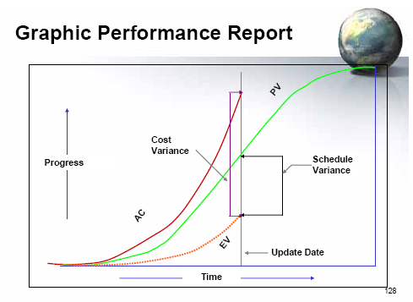
Graphic Representation

Slide 45
Performance Indexes
Another analysis that can be done by using EVMS is that of Performance or establishing the project’s burn rate.
Two examination of performance are available to the project manager:
Schedule Performance Index (SPI)
Cost Performance Index (CPI).

Slide 46
Schedule Performance Index (SPI)
A measure of schedule efficiency on a project. It is the ratio of earned value (EV) to planned value (PV).
The SPI is equal to earned value divided by planned value.
SPI = EV/PV
An SPI equal to or greater than one indicates a favorable condition and a value of less than one indicates an unfavorable condition.

Slide 47
Cost Performance Index (CPI)
A measure of cost efficiency on a project. It is the ratio of earned value (EV) to actual costs (AC).
The CPI is equal to the earned value divided by the actual costs.
CPI = EV/AC.
A CPI equal to or greater than one indicates a favorable condition and a value of less than one indicates an unfavorable condition.

Slide 48
Project Termination
Project termination (or close-out) is the last stage of managing the project, and occurs after the implementation phase has ended.

Slide 49
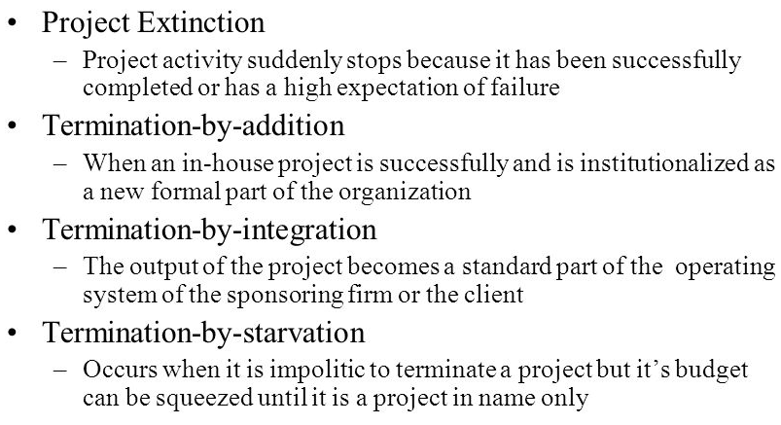
Types of Project Termination

Slide 50
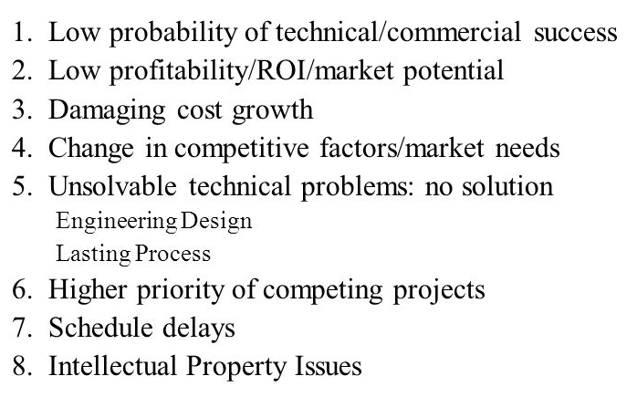
Most Common Reasons Projects Terminate

Slide 51
Summary
Milestones are tools used in project management to mark specific points along a project timeline.
These points may signal anchors such as a project start and end date, or a need for external review or input and budget checks.
A measure of cost efficiency on a project. It is the ratio of earned value (EV) to actual costs (AC).
The CPI is equal to the earned value divided by the actual costs.

Slide 52
Youtube Links
https://www.youtube.com/watch?v=lfIX8VwZpPE
https://www.youtube.com/watch?v=QTL0NU_S2Mc
https://www.youtube.com/watch?v=rAJYAgTBXEY
https://www.youtube.com/watch?v=mYUIMsc6Niw

Slide 53
Daily Quiz
Q1. EVA stands for.
Earned value analysis
Early value analysis
Exposure value analysis
Explicit value analysis
Q2. PV stands for.
Projected value
Planned value
Peculiar value
None of the above

Slide 54
Daily Quiz
Q3. EV stands for.
Explicit value
Exposure value
Earned value
Expected value
Q4. In project monitoring CV stands for.
Cumulative variance
Cumulative value
Cost variance
None of the above

Slide 55
Daily Quiz
Q5. In project monitoring SV stands for.
Standard value
Schedule variance
Schedule value
Standard variance
Q6. In project monitoring and control SPI stands for.
Supplementary performance index
Schedule performance index
Social performance index
Substitute performance index

Slide 56
Weekly Assignment
Q1. Describe the project monitoring and control cycle.
Q2. Discuss the Project Management Information System.
Q3. Describe the project termination and its process in detail.
Q4. Discuss the Earned Value Analysis and calculation of its components.

Slide 57
MCQ s
Q1. Who will be aware that for all projects, final technical and financial reports
Principal Investigator
Foremen
Supervisor
Clerk
Q2. Why projects are terminated?
Force majeure (e.g. earthquake, flooding, etc.)
Necessary conditions disappear
Lack of management support
All of the above

Slide 58
MCQ s
Q3. We generally extol the value and virtue of time as a
Critical parameter
Compact parameter
Complex parameter
None of the above
Q4. Projects are the means of_________organizational strategy
Implementing
Making
Terminating
None of the above

Slide 59
MCQ s
Q5. Which of the following is an incorrect activity for the configuration management of a software system? A. Internship management B. Change management C. Version management D. System management
Q6. Quality planning is the process of developing a quality plan applicable for.
Team
Project
Customers
project manager

Slide 60
Glossary Questions
Part of Question Bank.
Yet to be prepared for IV sem Batch 2020-22

Slide 61
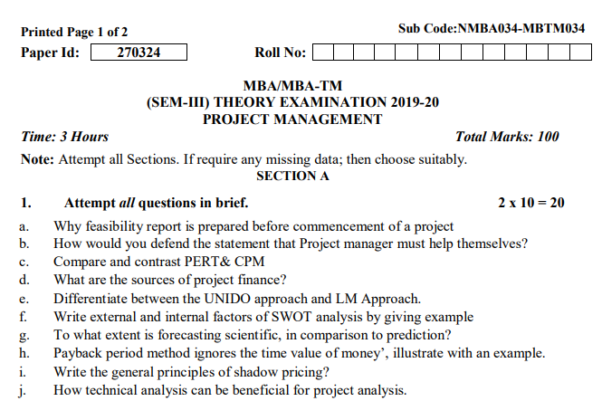
Old Question Papers

Slide 62
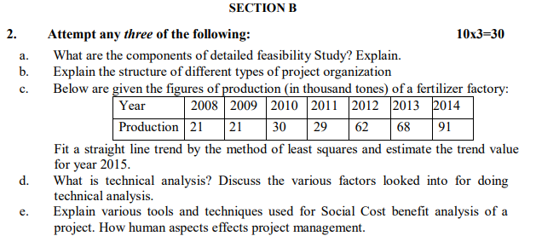
Old Question Papers

Slide 63
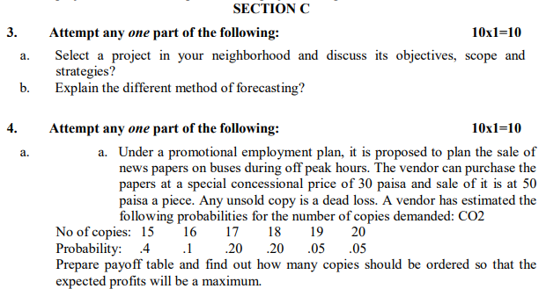
Old Question Papers

Slide 64
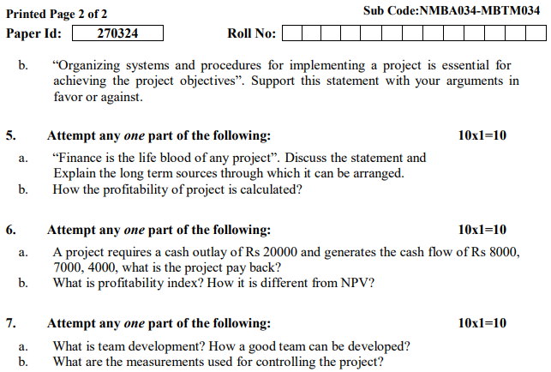
Old Question Papers

Slide 65
Expected Questions for University Exam
Q1. Discuss the project monitoring and control process.
Q2. Elaborate the project monitoring and control cycle.
Q3. Elaborate the earned value analysis with its components.
Q4. Explain the project termination and various types of terminations

Slide 66
Summary
The Monitoring and Control Process Group consists of those processes performed to observe project execution so that potential problems can be identified in a timely manner and corrective action can be taken, when necessary, to control the execution of the project.”
The earned value analysis is a project controlling procedure that, along with the planned and actual costs, includes the earned value.

Slide 67
References
Books:
1. Project Management – Achieving Competitive Advantage: Jeffrey K. Pinto (Pearson)
2. Project Management- A Managerial Approach: Jack R. Meredith Broyhill Samuel J. Mantel, Jr (John Wiley & Sons)
4. Project- Preparation, Appraisal, Budgeting and Implementation: Chandra Prasanna - (TMH)
Web-links:
https://www.projectplan365.com/articles/tracking-gantt/
https://www.google.com/search?q=project+termination+process+in+project+management&sxsrf=ALeKk00XHUBeTKGmy4P_46lOCdOVVwx4qQ:1592294685524&source=lnms&tbm=isch&sa=X&ved=2ahUKEwjtwu7474XqAhUTT30KHe6sCzsQ_AUoAXoECA0QAw&biw=1366&bih=625#imgrc=M3vpROgkXZRujM
http://www.technologyuk.net/computing/software-development/project-management/project-termination.shtml#:~:text=Project%20termination%20(or%20close%2Dout,handed%20over%20to%20the%20client.

Slide 68
Thank You

